Slide 1
Analysis Of Planning Approaches
22wh1a6637-Lahari
22wh1a6662-Sri Vaishnavi
22wh1a6603-Meghana
23wh5a6601-karuna
22WH1A6613-SIVANI
2w

Slide 2
Introduction
AI is revolutionizing the planning process by helping identify the best course of action, automating tasks, and evaluating options.
It overcomes human limitations by handling large data sets and complex problems, speeding up the process, and making recommendations.
AI can analyze multiple options and recommend the best one, making decision-making more efficient.

Slide 3
Goal-Based Planning
Goal-based planning focuses on achieving specific goals by considering the current state and the actions needed to transition from the current state to the desired goal state.
Goal-based planning involves defining a set of goals that the AI system needs to achieve.
The planning system then searches for a sequence of actions that will lead to the goal state from the current state.
Example algorithms: Strips, A* search.
Advantages:
Clear and focused on achieving specific objectives.
Efficient for problems with well-defined goals.
Disadvantages:
Limited flexibility, as it doesn't handle scenarios where goals might change dynamically.
May not be efficient in complex environments with many possible states and actions.

Slide 4
Rule-Based Planning
Rule-based planning relies on a set of predefined rules to make decisions and plan actions.
Uses a collection of if-then rules to determine which actions to take based on the current state.
Each rule defines a condition and the corresponding action to execute when that condition is met.
Example systems: expert systems like mycin, production systems.
Advantages:
Easy to understand and implement for well-defined domains.
Highly interpretable, making it easier to debug and modify.
Disadvantages:
Can become complex and unwieldy as the number of rules increases.
Not adaptable to dynamic or unforeseen situations where new rules may be required.

Slide 5
Utility-Based Planning
Utility-based planning involves making decisions based on a utility function that quantifies the desirability of different outcomes.
Utility-based systems assign a numerical value (utility) to different outcomes or states, representing their relative desirability.
The planning system aims to maximize the overall utility by selecting actions that lead to the highest utility states.
Example algorithms: markov decision processes (mdps), reinforcement learning.
Advantages:
Flexible and can handle complex trade-offs between different objectives.
Suitable for dynamic environments where the optimal decision may vary over time.
Disadvantages:
Defining an appropriate utility function can be challenging.
May require significant computational resources, especially in large state spaces.

Slide 6
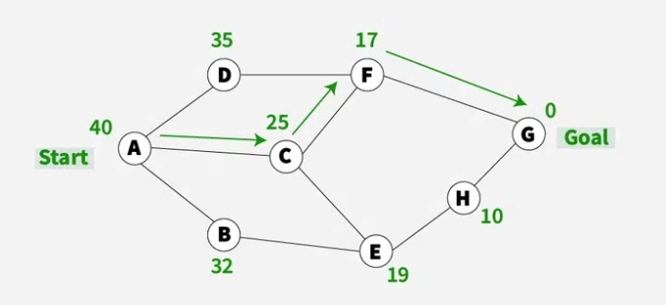
Best First Search (Informed Search)
The idea of best first search is to use an evaluation function to decide which adjacent is most promising and then explore.
It falls under the category of heuristic search or informed search.
We use a priority queue or heap to store the costs of nodes that have the lowest evaluation function value.
It is the most common approach in ai planning .

Slide 7
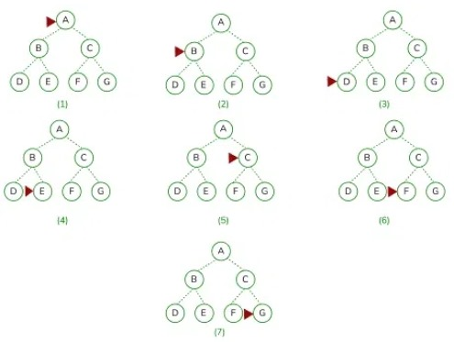
Depth First Search (DFS)
Depth First Search is a traversing algorithm used in tree and graph-like data structures.
Starting at the root node, the algorithm proceeds to search to the deepest level of the search tree until nodes with no successors are reached.
Suppose the node with unexpanded successors is encountered then the search backtracks to the next deepest node to explore alternative paths.

Slide 8
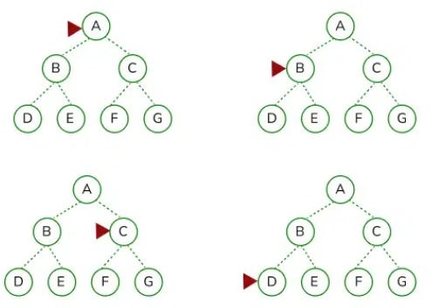
Breadth First Search (BFS)
Depth First Search is a traversing algorithm used in tree and graph-like data structures.
Originally it starts at the root node, then it expands all of its successors, it systematically explores all its neighbouring nodes before moving to the next level of nodes.
It extends the root node’s immediate neighbours, then to their neighbours, and so on, lasts until all the nodes within the graph have been visited or until the specific condition is met.

Slide 9
conclusion
Project management is a critical component of any business. The ability to organize and oversee a project from beginning to end is essential for any company looking to be successful.
Artificial intelligence (AI) can help businesses overcome these challenges.
AI allows businesses to make better decisions, faster.
Ai-based project management tools also automate many tasks that are typically performed by humans, such as task allocation, resource allocation, and communication.
Overall, AI-based project management tools offer a number of benefits that can help businesses of all sizes become more successful

